Slide 1
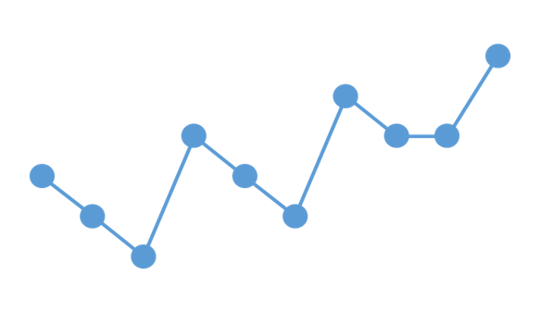
Scenarios in ViVa
Visibility for Vaccines presents
A series of lessons designed to lead you through the stock visualizations on the ViVa Platform.

Slide 2
VACCINE STOCK SITUATION: STOCK OUT
Scenario 2
ViVa Visualization

Slide 3
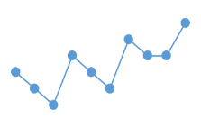
ViVa Country
Welcome back to
Ten months ago, the Ministry of Health began using the Visibility for Vaccines (ViVa) platform developed by UNICEF and WHO to support the Expanded Immunization Programme. In this scenario presentation, you will discover the fundamentals through the actions of the team.
SCENARIO TWO
This presentation will help you to answer the following questions
What does a stock-out look like in ViVa?
How should it be interpreted?
What kinds of corrective measures should be taken?

Slide 4
Ministry of Health
Today the EPI Manager receives an email alert from ViVa showing that the National Vaccine Store is headed towards a stock-out for the measles vaccine.

Slide 5
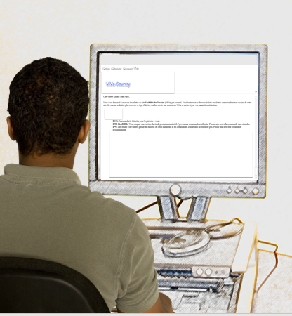
Ministry of Health
According to the message:
Measles-R:
You are headed towards a stock out soon, and confirmed orders will not be sufficient. Place a new order immediately.

Slide 6
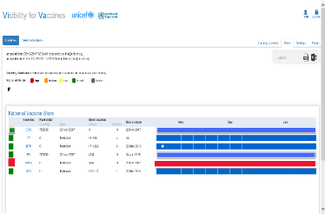
National Vaccine Store
ViVa Country: Platform User
The Cold Chain Officer also sees the status change in ViVa for the measles vaccine in the stock overview
She immediately clicks on the measles stock level to learn more.

Slide 7
RED ALERTS in ViVa
Understanding the Platform
What does it mean?

Slide 8
In ViVa, the red alert indicates that a stock out is either already taking place or is imminent.
Let’s see why this happening.

Slide 9
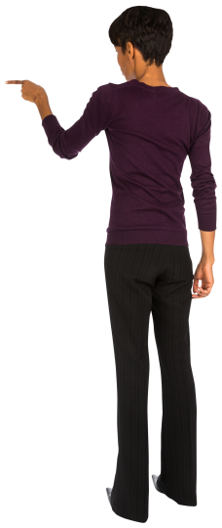
The minimum stock level for measles is set at 3 months. That includes 1 month of safety (buffer) stock, and 2 months needed between placing and receiving an order.

Slide 10
As of today, the measles vaccine is below the minimum stock level.

Slide 11
Based on our estimated consumption, we can expect to be stocked out 6 weeks from today.

Slide 12
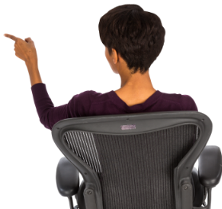
ViVa shows that there is a confirmed order arriving three months from today

Slide 13
We also have a planned order which is still to be confirmed.

Slide 14
This confirmed order is too far in the future to prevent the imminent stock out

Slide 15
The stock level will fall below the minimum level within a month of receipt

Slide 16
This quantity of doses is insufficient

Slide 17
If no purchase order is placed for this planned order of measles, we will be stocked out again.

Slide 18
Escalate to EPI Manager
The Cold Chain Team immediately follows up with the EPI Manager at the Ministry of Health.
He views the situation in ViVa and confirms the team’s initial findings.
Risk identified
The EPI Manager knows that if there is a stock out at the National Vaccine Store, there is a strong possibility that stock out will also occur at the lower levels.
Immunization against measles will be paused.

Slide 19
Team Reflection
The EPI Manager is interested in knowing what caused the stock-out situation. The team looks through the historical data in ViVa to draw conclusions.

Slide 20
The last order was received 10 weeks ago. Within a month’s time, the stock level dropped below the minimum level

Slide 21
The EPI Manager and the team consider the following:
Consumption seems higher than anticipated.
Did we underestimate our target population when forecasting?
Are we wasting vaccines because of stock management issues?
Are we wasting vaccines because of poor session planning?

Slide 22
The frequency of supply is not supporting the actual consumption.
Should we be ordering more frequently?

Slide 23
These are sharp declines in measles stock levels.
Is the measles vaccine being used effectively at the point of immunization?

Slide 24
IMPENDING STOCKOUT
Taking Corrective Actions
What should we do?

Slide 25
Corrective actions
Quick Assessment
#1
#2
# 3
Move the confirmed order forward.
Place a new order for the measles vaccine as soon as possible.
Establish the root cause for the declines in stock levels.

Slide 26
Taking Immediate Action
Request an earlier delivery
Why?
To avoid the imminent stock out, the confirmed order in the pipeline should be moved forward.
How?
I have sent an email to the Immunization Specialist at the UNICEF Country Office.
This information will be conveyed to the Vaccine Center at UNICEF’s Supply Division

Slide 27
UNICEF Country Office
ViVa Country
We can move the confirmed order forward.
However, we won’t be able to increase the quantities unless there’s more money.
As for the planned order, we cannot place the order until we receive funds.

Slide 28
Taking Immediate Action
Request the fund release
Why?
Without the fund release, the planned order will not take place. This is usually a lengthy process so we need to start now.
How?
I have sent an official memo to our Finance Ministry. We are meeting on this urgent situation.
I exported and attached the visualization seen in ViVa to support the urgency of the situation

Slide 29
Good news!
Outcome
The order for the measles vaccine has been received so we are not completely stocked out.
A purchase order has been placed for another order of measles vaccines.

Slide 30
ViVa Country Context
Root Cause
What happened?
There was a high level of wastage occurring at some of the health clinics. Multi-dose vials were not being used efficiently.
This explains some of those sharp declines in vaccine stock levels.
The Ministry of Health will work on strengthening performance at this level for ViVa Country.

Slide 31
Summary
In this scenario, we took corrective measures to lessen the impact of a stock-out situation. We were able to advance a confirmed order and receive an urgent funds-release for a planned order.
In this session we looked at:
1
The significance of a red status alert in ViVa.
2
Characteristics of a stock-out as seen in ViVa.
3
Actions that can be taken for an imminent stock-out.

