Slide 1
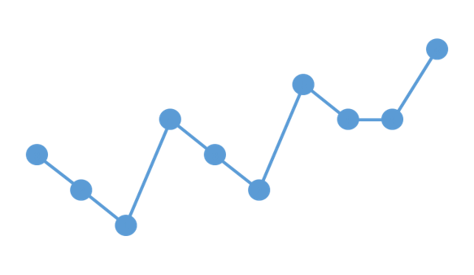



Scenarios in ViVa
Visibility for Vaccines presents
A series of lessons designed to lead you through the stock visualizations on the ViVa Platform.

Slide 2
VACCINE STOCK SITUATION: OVERSTOCKING
Scenario 3
ViVa Visualization

Slide 3


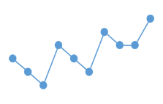

ViVa Country
Welcome to
Ten months ago, the Ministry of Health began using the Visibility for Vaccines (ViVa) platform developed by UNICEF and WHO to support the Expanded Immunization Programme. In this scenario presentation, you will discover the fundamentals through the actions of the team.
SCENARIO THREE
This presentation will help you to answer the following questions
What does overstocking look like in ViVa?
How should it be interpreted?
What kinds of corrective measures should be taken?

Slide 4
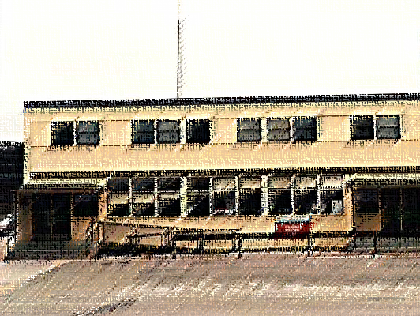
Ministry of Health
Today the EPI Manager receives an email alert from ViVa showing that there is overstocking of pentavalent at the National Vaccine Store.

Slide 5
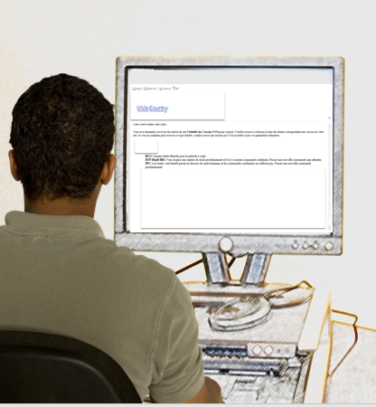
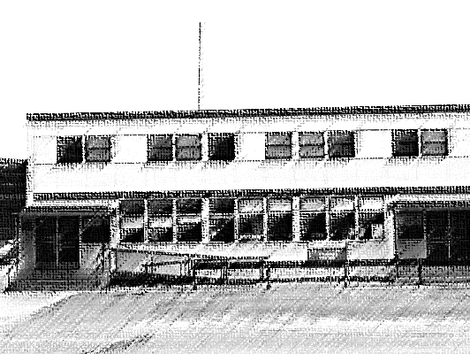
Ministry of Health
According to the message:
DTP-HepB-Hib:
Overstocked!
You have confirmed orders. Consider delaying the next delivery.

Slide 6
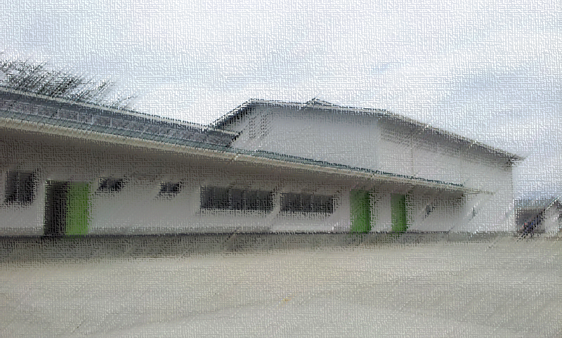


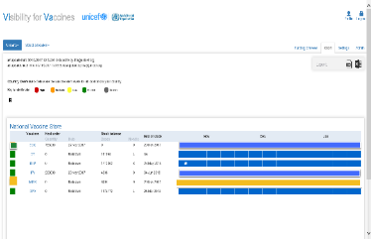
National Vaccine Store
The Cold Chain Officer also sees the status change in ViVa for pentavalent in the country overview
She immediately clicks on the vaccine to learn more.

Slide 7

YELLOW ALERTS in ViVa
Understanding the Platform
What does it mean?

Slide 8
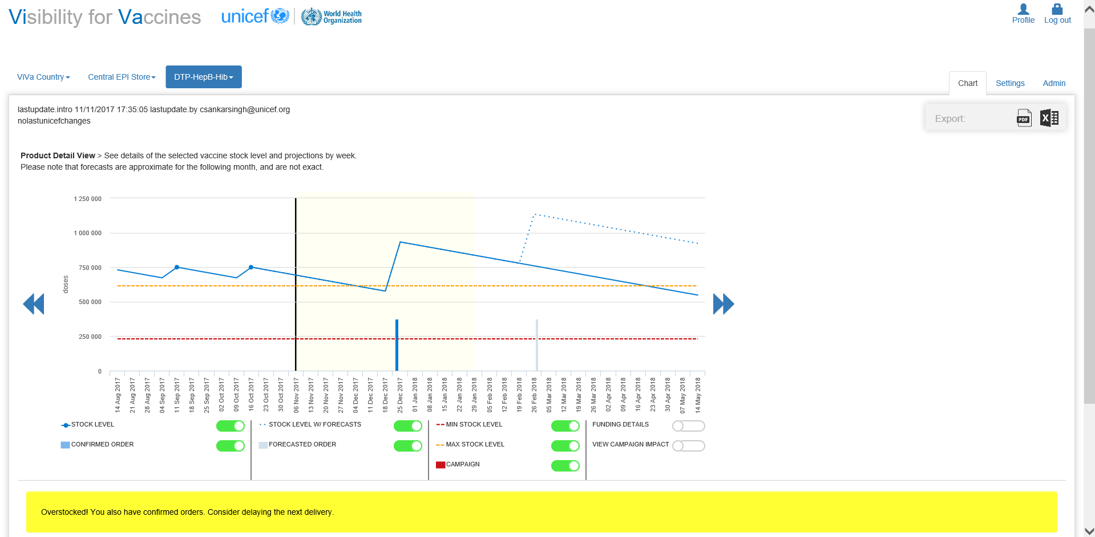

In ViVa, the yellow alert indicates that overstocking is either already taking place or is expected.
Let’s see why this happening for ViVa Country.

Slide 9
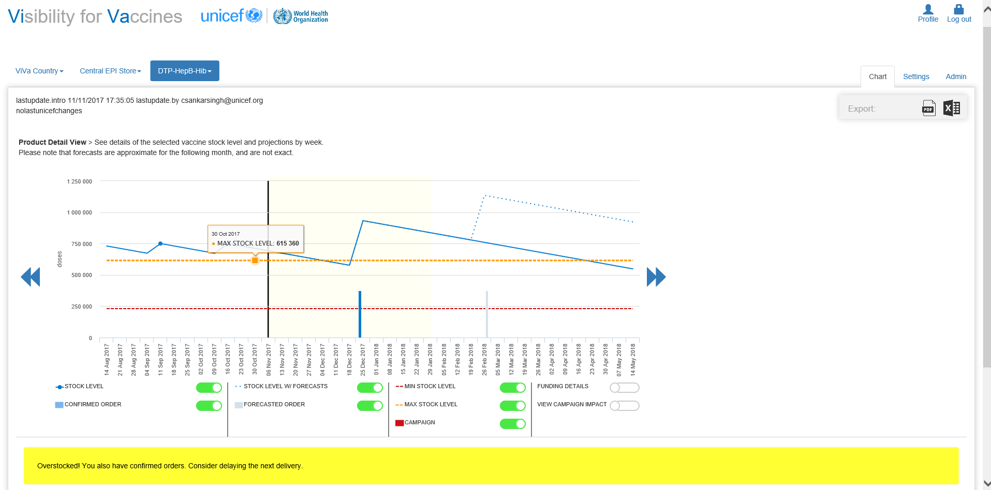

The maximum stock level is set to 7 months. It is the largest amount of stock we should have in stock, and includes the minimum stock plus the amount of stock used between orders.

Slide 10
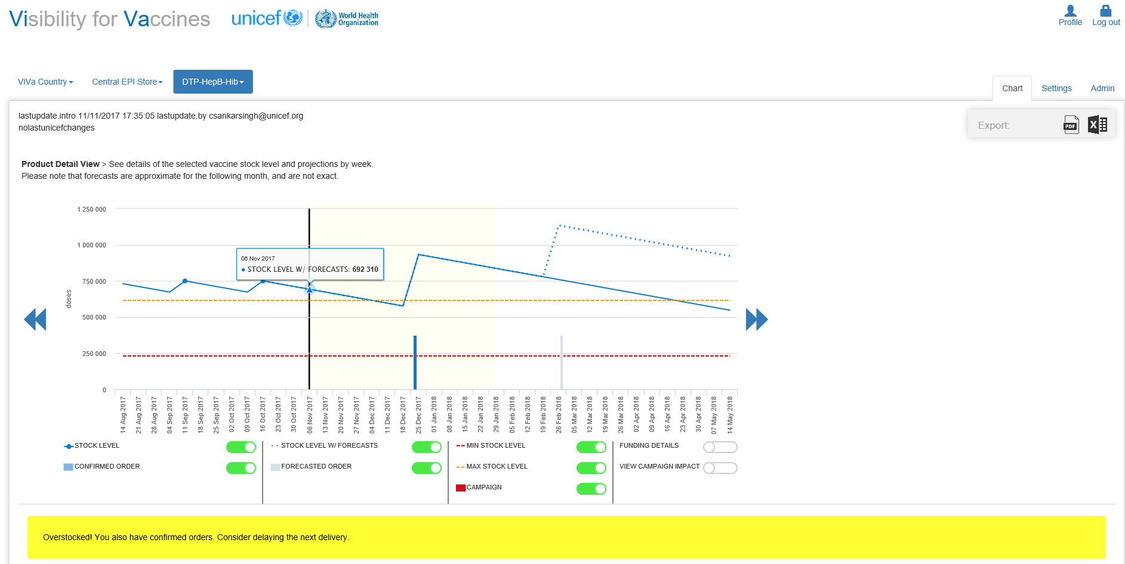
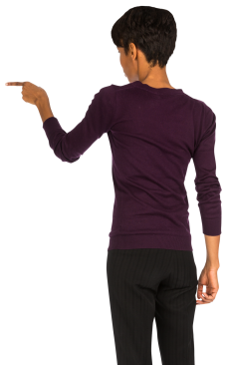
As of today, pentavalent is above the maximum stock level for ViVa Country.

Slide 11
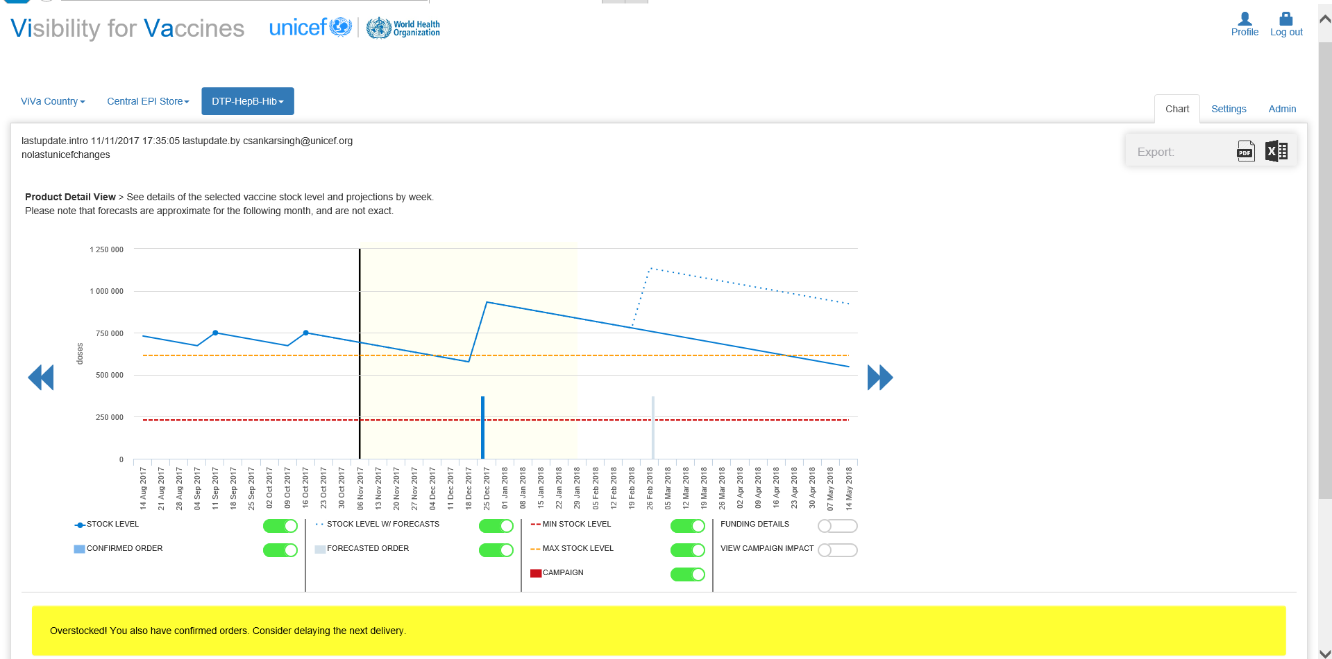
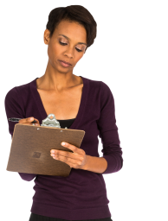
Based on the estimated consumption rate, the current stock of pentavalent will sustain ViVa Country for the next 4 months.

Slide 12
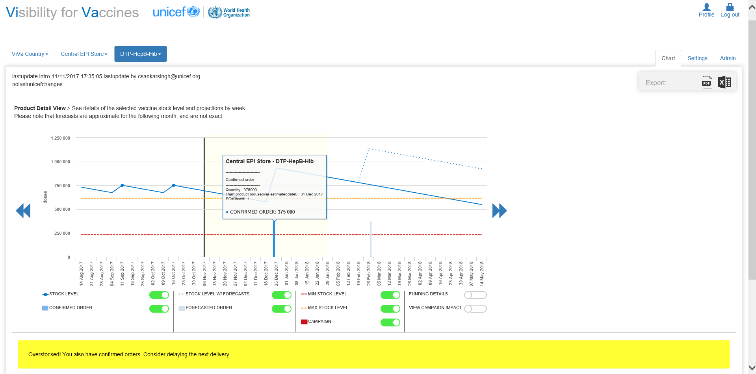

However, a confirmed order is expected in less than two months

Slide 13
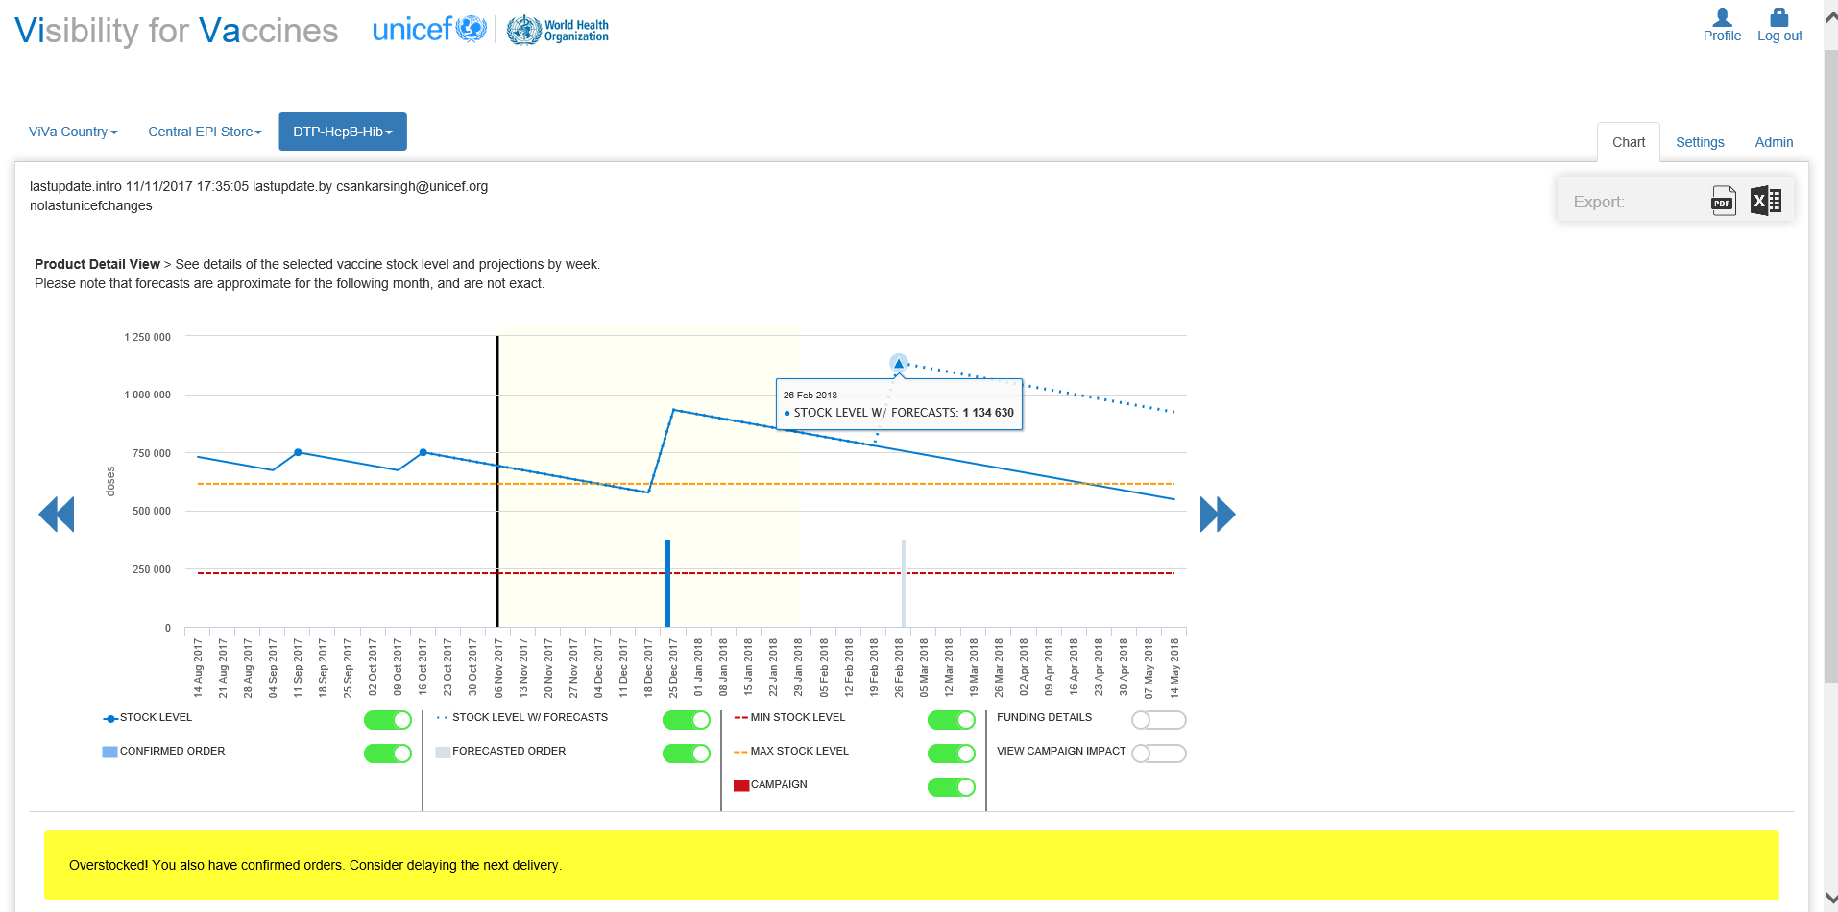

There is also a planned order two months after the confirmed order

Slide 14
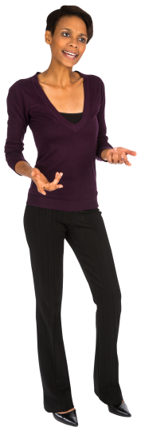
These orders will push the stock level even further beyond the maximum level for pentavalent here in ViVa Country

Slide 15

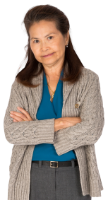
The National Vaccine Store is running out of storage capacity. We are introducing a new vaccine next year and need to reserve space in the cold store.

Slide 16
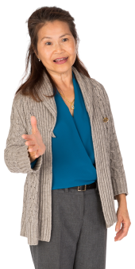
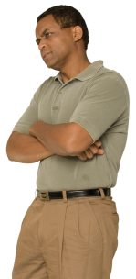


Escalate to EPI Manager
The Cold Chain Team immediately follows up with the EPI Manager at the Ministry of Health.
He views the situation in ViVa and confirms the team’s initial findings.
Risk identified
The EPI Manager knows that overstocking of pentavalent at the National Vaccine Store means that cold storage capacity is reduced.
This creates additional problems for other vaccine deliveries. Storage space for the rotavirus vaccine introduction is decreased.

Slide 17



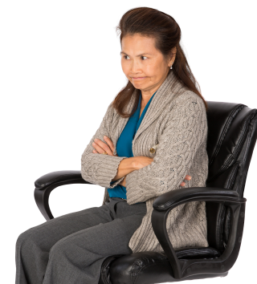


Team Reflection
The EPI Manager is interested in the cause of the overstocking. The team looks through the historical data in ViVa to draw conclusions.

Slide 18
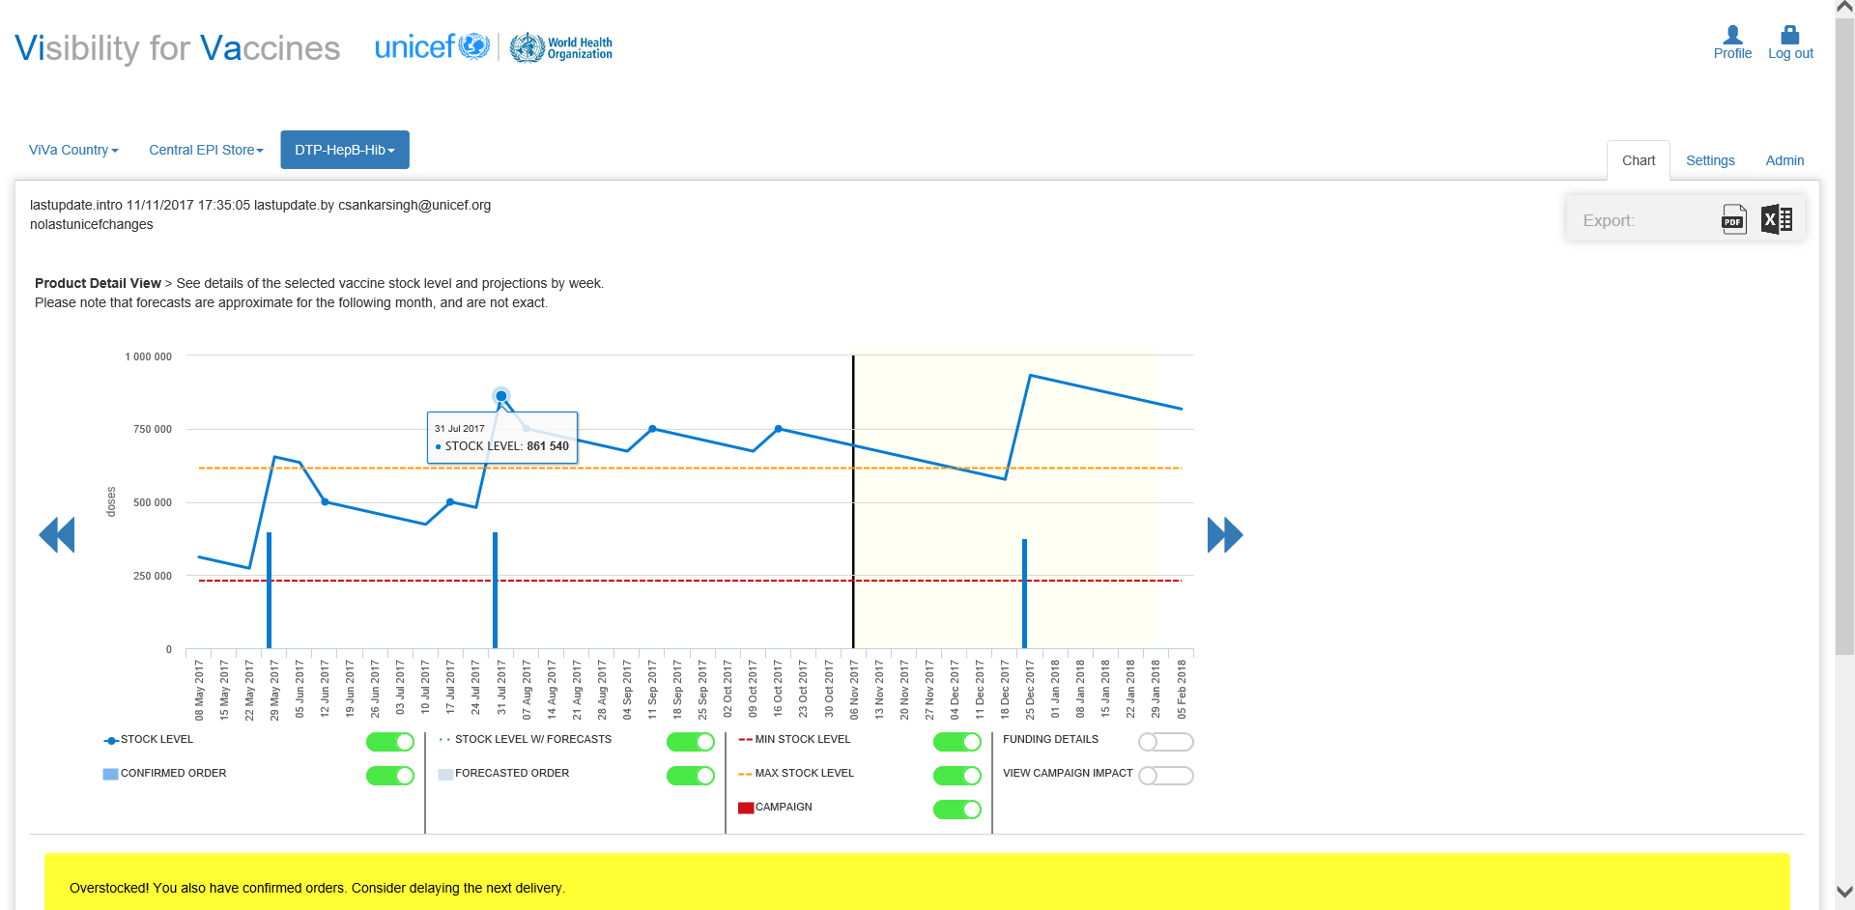

The last order received by the National Vaccine Store pushed the pentavalent stock over the maximum level for ViVa Country.
Should we be ordering less?
Did we overestimate our needs?

Slide 19

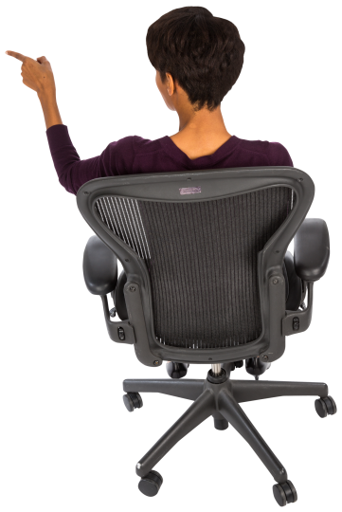
The updates before that show that the stock levels did not change much.
Did pentavalent leave the National Vaccine Store in those weeks?

Slide 20
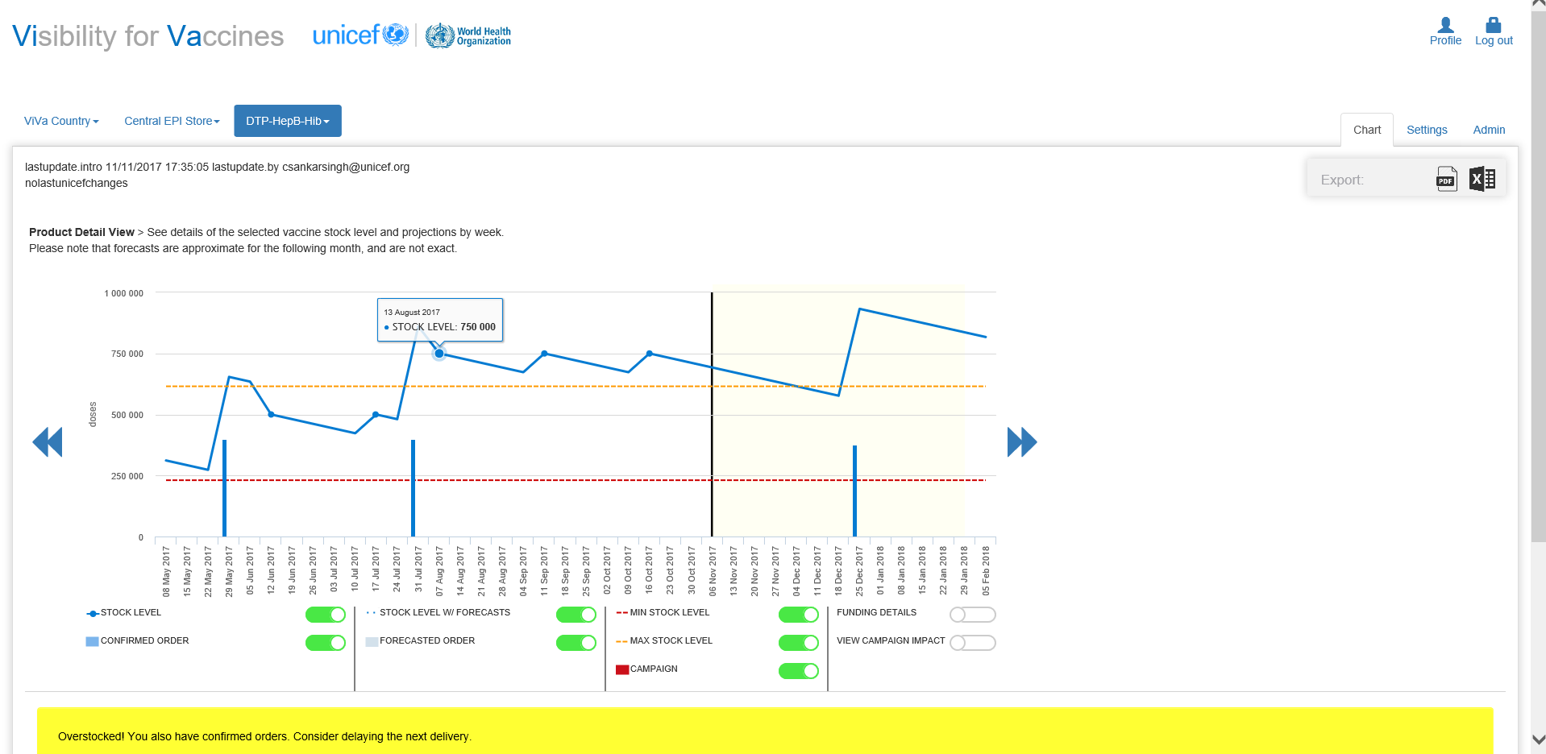

The updates after show no change in quantities at all.
This does not reflect the estimated consumption for ViVa Country.
Did we distribute pentavalent to all our district stores?

Slide 21
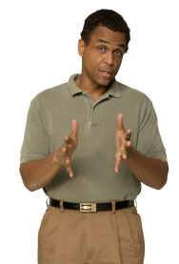
Pentavalent vaccines haven’t been dispatched from the National Vaccine Store.

Slide 22
OVERSTOCKING
Taking Corrective Actions
What should we do?

Slide 23
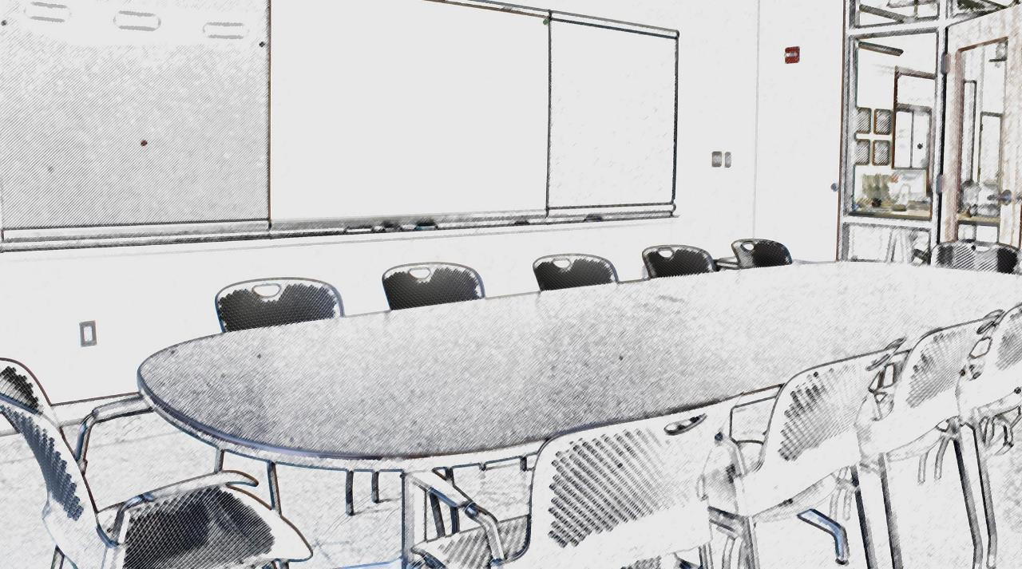


Corrective actions
Quick Assessment
#1
#2
# 3
Defer the confirmed order to a later date
Cancel any other orders of pentavalent in the pipeline.
Establish the root cause of the distribution problem.

Slide 24


Taking Immediate Action
Request a deferral/Cancel the order
Why?
The confirmed order in the pipeline should be deferred for at least 4 months. Not only are we running out of space, but if we’re not careful, vaccines may soon expire.
How?
I have sent an email to the Immunization Specialist at the UNICEF Country Office.
This information will be conveyed to the Vaccine Center at UNICEF’s Supply Division

Slide 25
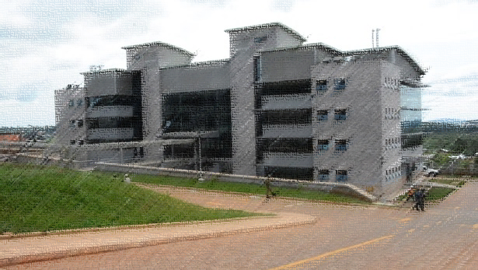

UNICEF Country Office
ViVa Country
Smart move, we can defer the order.
As for the planned order, we will not place the order until we receive funds, so my advice is to action that at a later date.

Slide 26
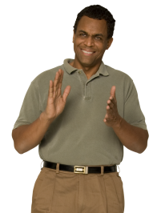
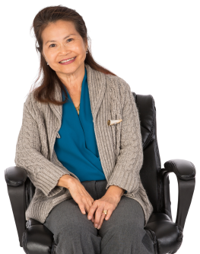
Good news!
Outcome
The order for pentavalent has been deferred.
We will need to monitor the pipeline in ViVa to action orders more carefully.

Slide 27
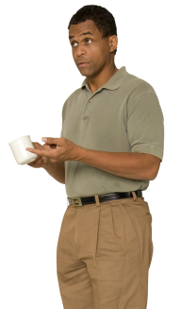
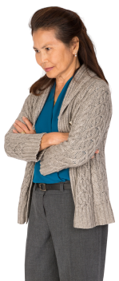
ViVa Country Context
Root Cause
What happened?
We have had transportation issues. Our provincial stores haven’t been able to send any vaccines down to district level for months. That’s why there has been low uptake of the vaccine.
Moving forward
We also need to check the physical inventory for any soon-to-be expiring vaccines.

Slide 28
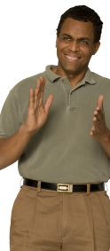
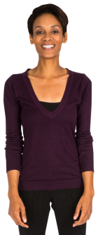

Summary
In this scenario, we took corrective measures to curtail overstocking at the National Vaccine Store. We were able to delay a confirmed order and pinpoint some local issues affecting our Expanded Immunization Programme.
In this session we looked at:
1
The significance of a yellow status alert in ViVa.
2
Characteristics of an overstocking situation seen in ViVa.
3
Actions that can be taken for overstocking.

