Slide 1
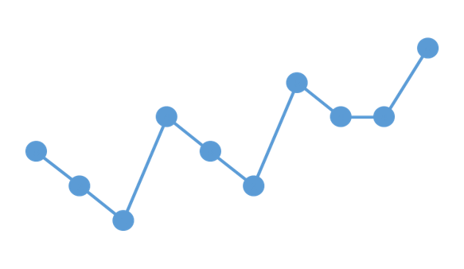



Scenarios in ViVa
Visibility for Vaccines presents
A series of lessons designed to lead you through the stock visualizations on the ViVa Platform.

Slide 2
VACCINE STOCK SITUATION: NO ALERT DETECTED
Scenario 1
ViVa Visualization

Slide 3


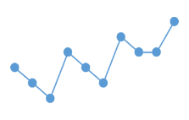

ViVa Country
Welcome to
Ten months ago, the Ministry of Health began using the Visibility for Vaccines (ViVa) platform developed by UNICEF and WHO to support the Expanded Immunization Programme. In this scenario presentation, you will discover the fundamentals through the actions of the team.
SCENARIO ONE
This presentation will help you to answer the following questions
What does an acceptable stock situation look like in ViVa?
What are the graphical elements shown in ViVa?
How do I interpret the timeline visualization in ViVa?

Slide 4
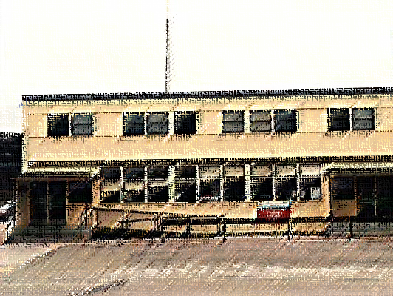
Ministry of Health
Today the EPI Manager receives an email notification from ViVa showing the vaccine stock level situation at the National Vaccine Store.

Slide 5

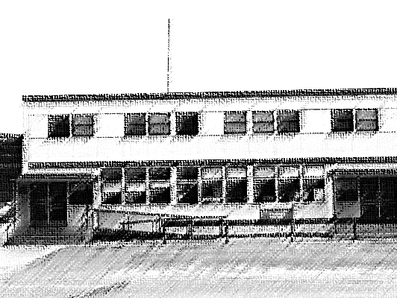


Ministry of Health
There are no alerts detected for the coming period.
OPV: No alert detected for the coming period.
DTP-HepB-Hib: No alert detected for the coming period.
Measles-R: No alert detected for the coming period.

Slide 6
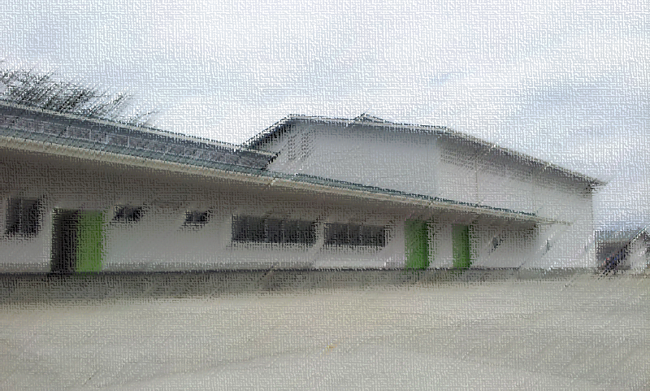


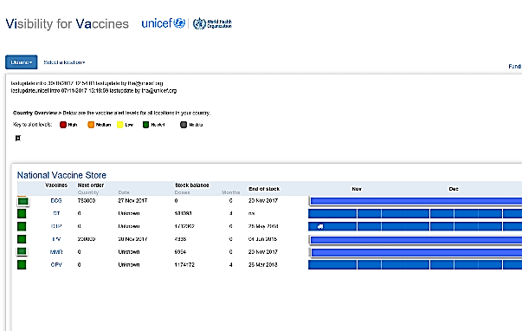
National Vaccine Store
The Cold Chain Officer also logs into ViVa to update the vaccine stock levels.
In the overview, she sees that there are no alerts detected for vaccine stock levels at the National Vaccine Store.
She clicks on the OPV vaccine to learn more.

Slide 7

GREEN ALERTS in ViVa
Understanding the Platform
What does it mean?

Slide 8
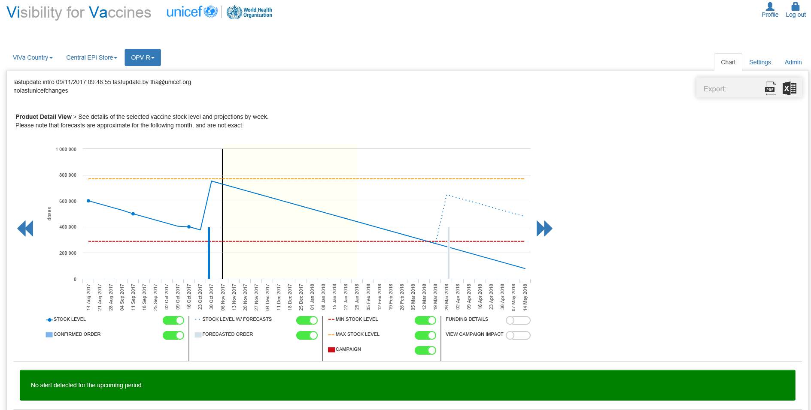

This green status means that as of today, the OPV stock situation is within an acceptable level for the specified upcoming period.
How do we know this?

Slide 9

The black line seen on the graph represents your current date.

Slide 10
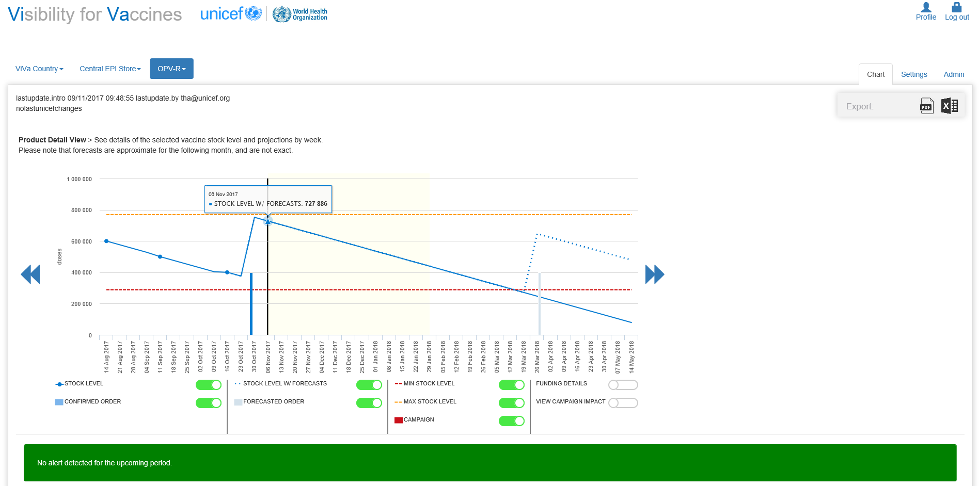

As of today, the OPV vaccine stock level for ViVa Country is just under 730,000 doses.

Slide 11
The blue line shows the projected stock level for OPV.

Slide 12
Today there are 727 886 doses of OPV in the National Vaccine Store for ViVa Country
In 3 months, there will be around 400,000 doses based on the projected consumption.

Slide 13

The blue line shows the projected stock level for OPV.
The projected consumption is based on our annual requirements submitted to UNICEF during the annual forecast exercise. ViVa takes this number and calculates an estimated weekly consumption rate.

Slide 14
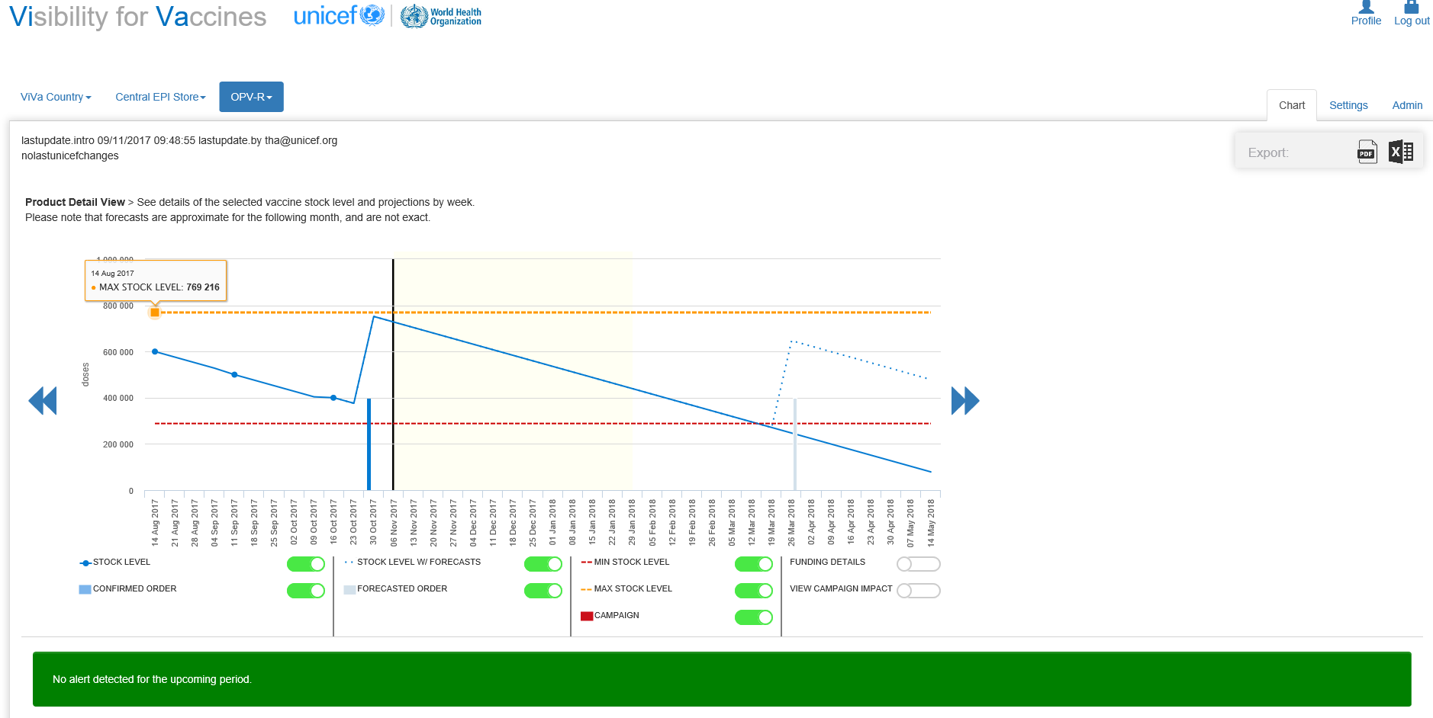
This orange line is the maximum stock level for OPV.

Slide 15
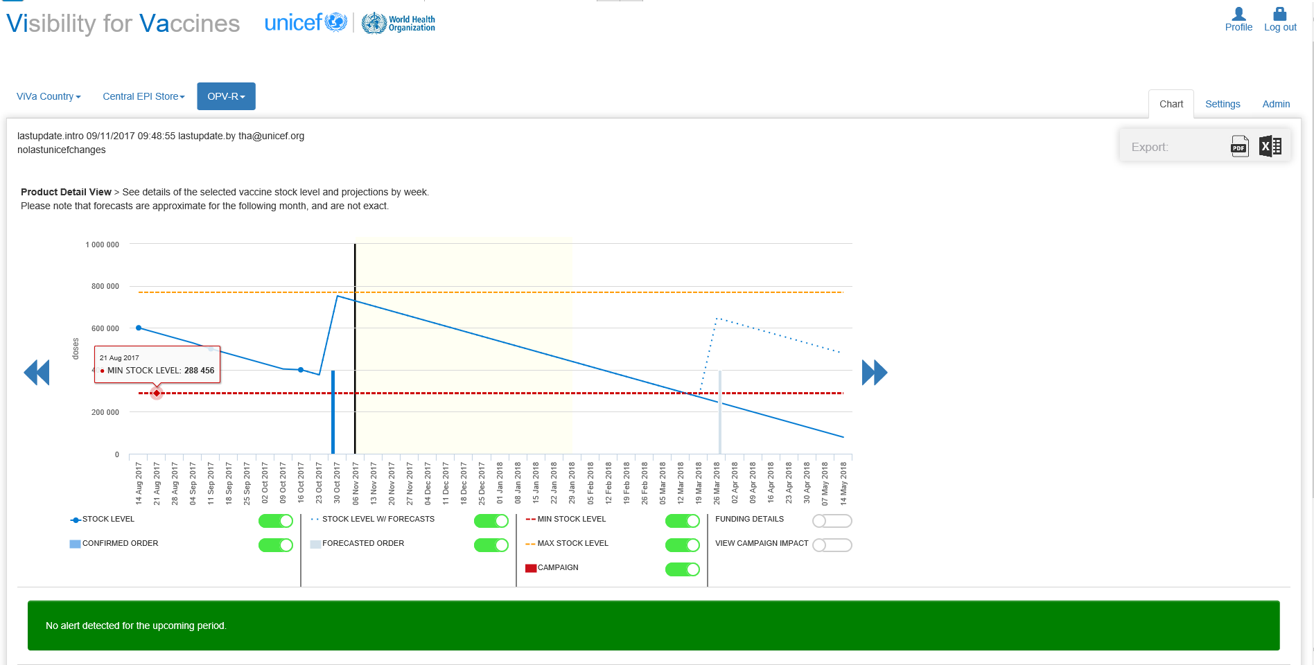
This red line is the minimum stock level for OPV.

Slide 16

This orange line is the maximum stock level for OPV.
This red line is the minimum stock level for OPV.
By default, ViVa sets the minimum as 3 months of remaining stock and the maximum as eight months of stock. However, this should be changed based on the individual stocking policy for each vaccine in your country

Slide 17

Here we can see that the OPV stock level will be between the maximum and minimum levels for the upcoming alert period.

Slide 18
The alert period is the part of the timeline highlighted in pale yellow.
The alert period is the period of time that ViVa will look into the future to calculate an alert

Slide 19

The alert period for our ViVa Country is set to 3 months.
It takes about 10 weeks between placing an order for a vaccine and when it arrives in-country. This is the lead time for OPV in ViVa Country.

Slide 20
Based on this lead time, we’ve decided to set our alert period to 3 months in ViVa. It gives us enough time to plan ahead.

Slide 21

From the graph, ViVa Country will have OPV between the minimum and maximum levels for the next 5 months.

Slide 22


The Alert Period
Scenario 1: takeaway
The GREEN status generated in ViVa indicates that the vaccine stock level is currently within the maximum and minimum levels for the country and its alert period.
#1
#2
#3
The alert period should be set to the minimum amount of time, starting from today, that a country needs to:
mobilize resources,
place an order &
receive the shipment.
The alert period should be set to your country context.
It is the period of time into the future that you want to monitor your vaccine stocks.
The time needed to mobilize funding to order a vaccine should be considered in your lead times.

Slide 23

GREEN ALERTS in ViVa
Using the Platform
What should we do?

Slide 24

Monitor the Pipeline for future situations
What should we do?
Even if the stock situation doesn’t generate an alert for the upcoming period, the cold chain team must remain vigilant for any issues in the future.
Let’s see how we do this.

Slide 25
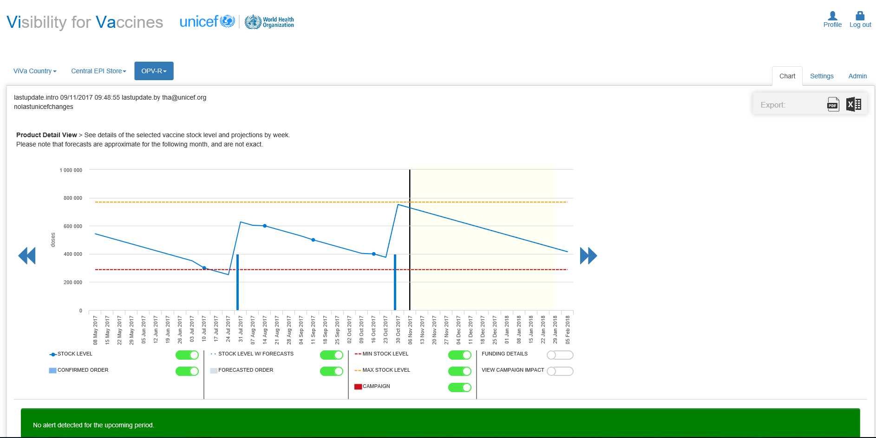

Monitoring the timeline in ViVa is easy with these scrolling features. Moving left of today’s date, I can consider the past.
Moving right of today’s date, I consider the future.

Slide 26

The accuracy of the past is dependent on the regular updates made by our Cold Chain Officer.

Slide 27
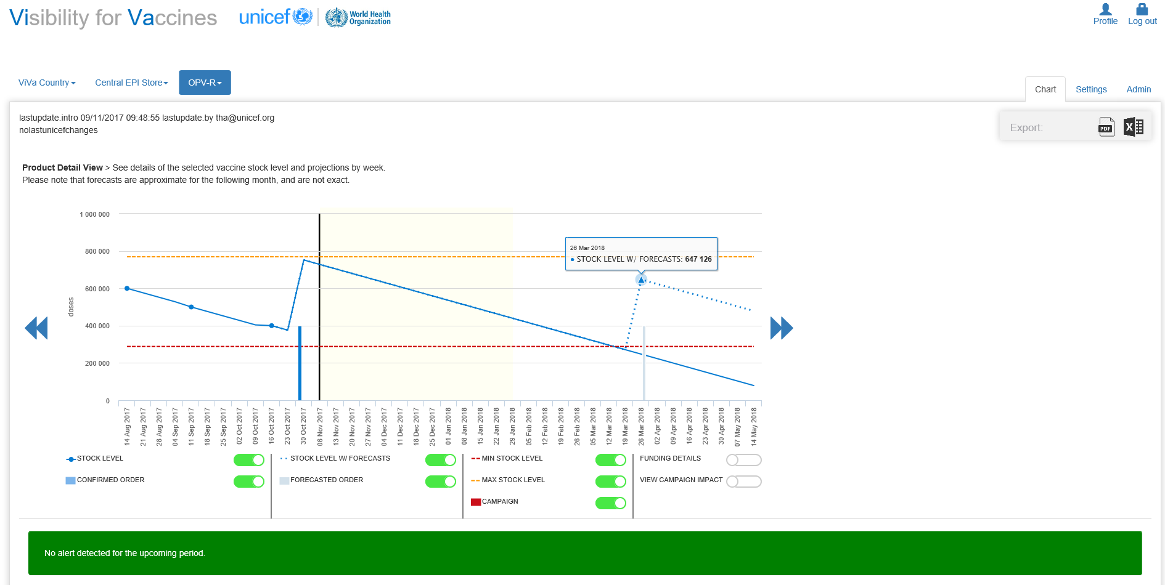

Confirmed orders show up as dark blue bars in ViVa. This will increase the vaccine stock level by the number of doses, and push the stock line upwards.

Slide 28
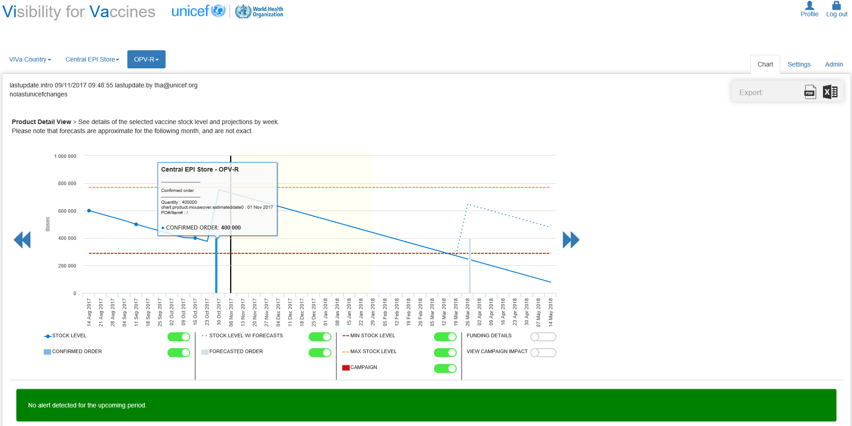
The historical data seen in ViVa shows:
A confirmed order was received one week ago for 400,000 doses of OPV.
This explains the incline of the stock level projection in ViVa.

Slide 29

Planned orders show up as grey bars in ViVa.

Slide 30
Planned orders are drawn from a country’s annual forecast.
There is a planned order for 400,000 doses of OPV in about 5 months time.

Slide 31

Only if this planned order is converted to a purchase order, can we expect to remain within the recommended stocking levels.

Slide 32

Follow up on the planned order
Quick Assessment
Why?
A planned order of OPV is not a confirmed order. There are indicators of expected orders but these require funding for procurement.
#1
Confirmed orders have been procured from the supplier, and have an estimated arrival date.
#2
The required lead time of 8-10 weeks from purchase order placement to delivery needs to be considered.
# 3
# 4
The status of this order should be followed-up with the EPI Manager as fund releases in ViVa Country can be lengthy.

Slide 33



The Cold Chain Officer at the National Vaccine Store follows up with the EPI Manager at the Ministry of Health
The EPI Manager learns that the order has not yet been placed because funds have not been released.

Slide 34


Taking Action
Request funds now
Why?
It can take up to 3 months to secure the release of funds here in ViVa Country.
Even though it may seem that we have 5 months to act, the process has to be started immediately to ensure vaccines arrive on time.

Slide 35

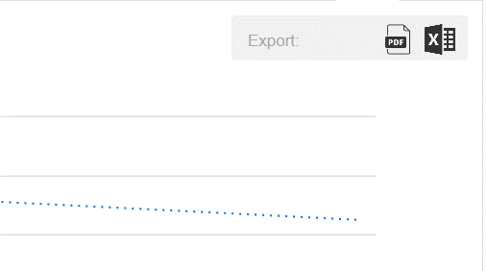
Take Action
Export & use visualization
Why?
ViVa allows us to export the graph. This can be attached to the official memo as a justification for the release of funds.

Slide 36


Good news!
Outcome
The EPI Manager was able to advocate and obtain a funds-release for the OPV Vaccines.
The timely action means OPV Vaccines will be replenished before the stock level drops below the minimum stock level.

Slide 37

Summary
In this scenario, we used ViVa to advocate for timely funding of a planned order. Actively monitoring the vaccine pipeline in ViVa even when there is no alert detected for the coming period allows the ViVa Country User to proactively manage vaccine stock levels.
In this session we looked at:
1
The significance of a green status alert in ViVa.
2
Key features of the timeline seen in ViVa.
3
Actions that can be taken for a planned order.

